Slide 1
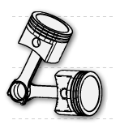
ENGINE DESIGNER
Internal combustion engine simulation software

Slide 2
What is it?
it is an application which allows us to parametrically define an internal combustion engine
in a user friendly way
with as few data as possible

Slide 3
What it does?
3D view of the engine (eyeball) and it‘s animation
basic diagrams (cycle, crank)
sound simulation
kinematic and dynamic analysis

Slide 4
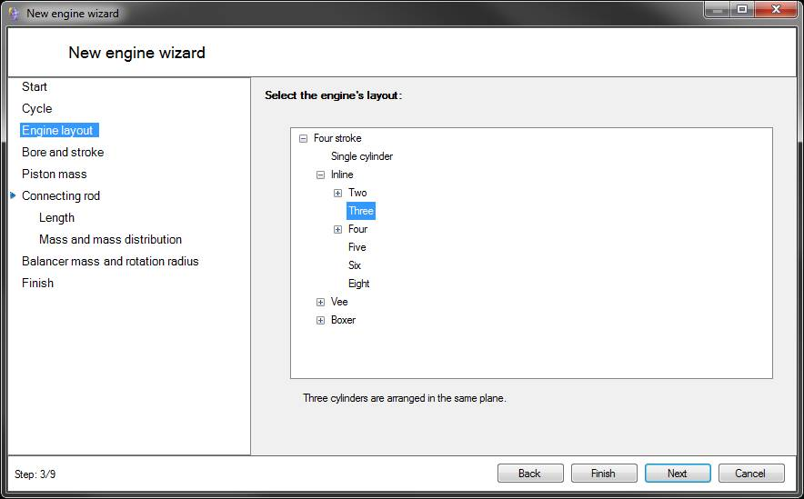
Defining the engine
powerful wizards
fully defined with default values
built-in most common engine layouts for two and four stroke engines

Slide 5
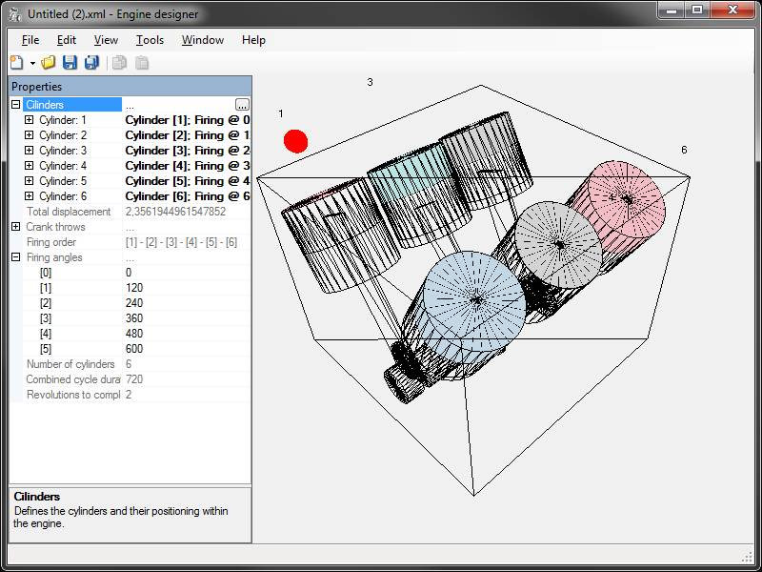
Engine view
3D view with eyeball camera
real scale simulation of kinematics and cycle
real time parametrical setup of components
“copy/paste as template” simplifies adding of cylinders
automatics validation and parameters checking for preventing physically impossible setups

Slide 6
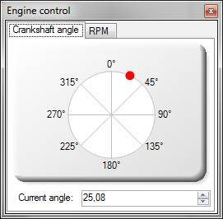
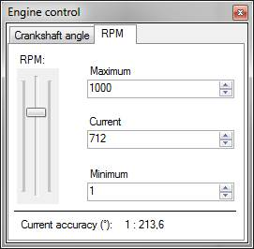
Engine control
crankshaft angle
or
RPM

Slide 7
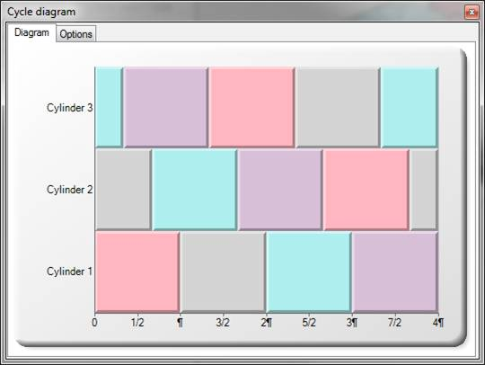
Cycle diagram
standard cycle diagram based on cylinder layout and firing angle
view in degrees or PI values
display of current crankshaft angle (cyclically or absolute)

Slide 8
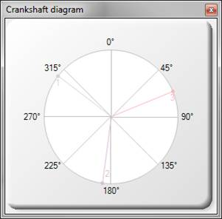
Crankshaft diagram
standard crankshaft diagram based on cylinder layout and firing angle
view in crankshaft degrees
display of current stroke for every crank throw

Slide 9


Sound simulation
simulation of firing sequence based on currently set RPM
simulation of uneven sound using left and right channel (for instance: V8 cross plane)

Slide 10
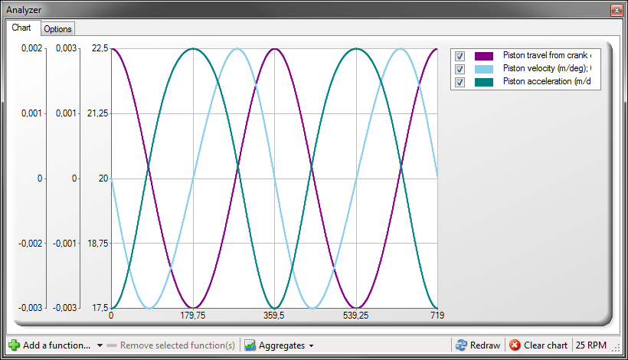
Analyzer 1
computation and display of kinematical and dynamical functions
on a powerful chart
smart function scaling
function adding, removing and hiding
average and superposition on click

Slide 11
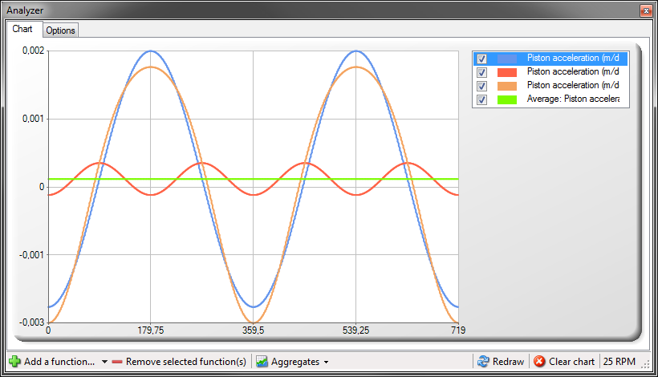
Analyzer 2
many functions available
predefined functions for most common analysis

Slide 12
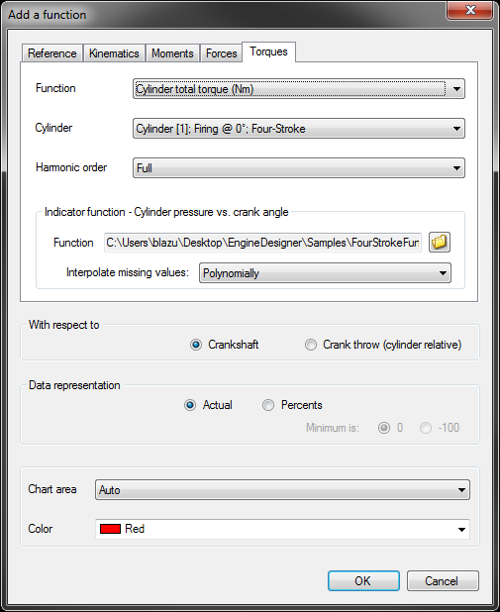
Analyzer 3
various options in manual adding mode offer broad analysis

Slide 13
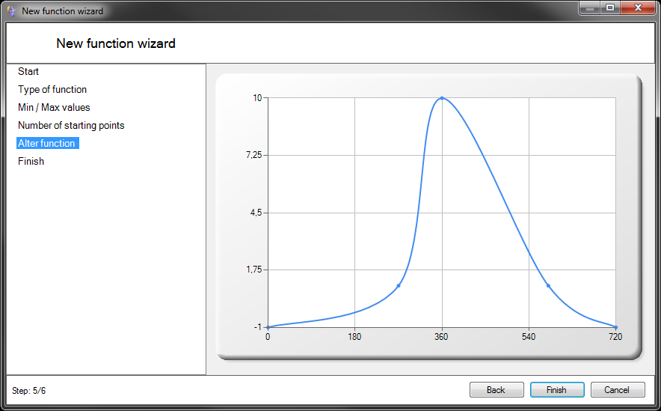
Indicator functions 1
used as input parameter when needed
for instance: cylinder pressure vs. piston angle
easily definable with wizard
customizable with dragging or parametrically

Slide 14
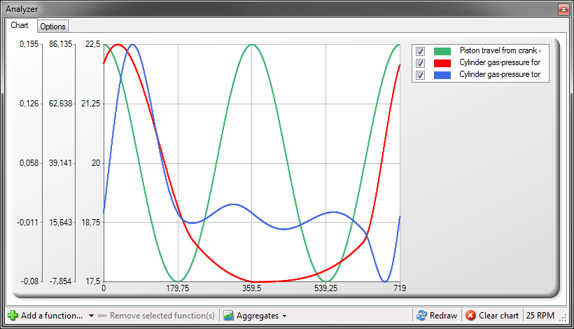
Indicator functions 2
piston position (green)
cylinder pressure vs. piston position indicator function (red) *
instantaneous torque vs. piston position (blue) *
*firing angle is 0°

Slide 15

Join the project!
Home page:
http://blazzumek.wix.com/enginedesigner
Community:
Facebook: Engine designer
Author: Blaž Umek
blazz.umek@gmail.com

